Slide 1
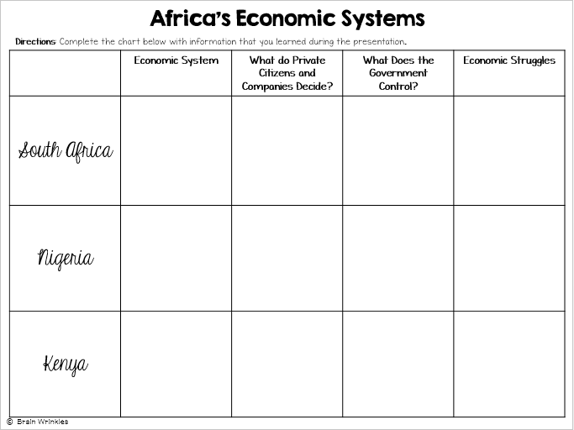
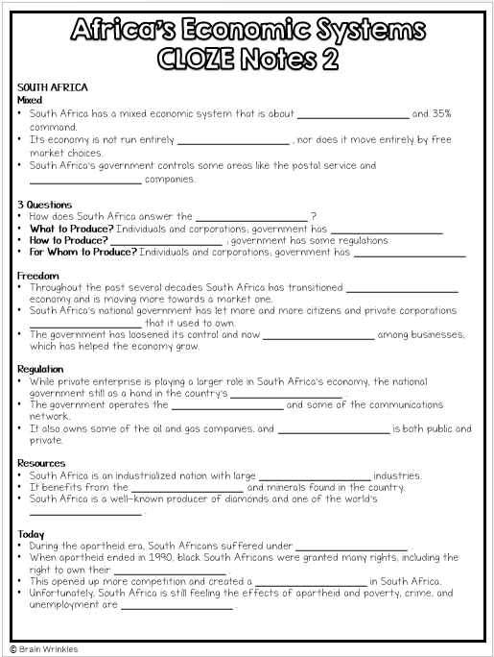
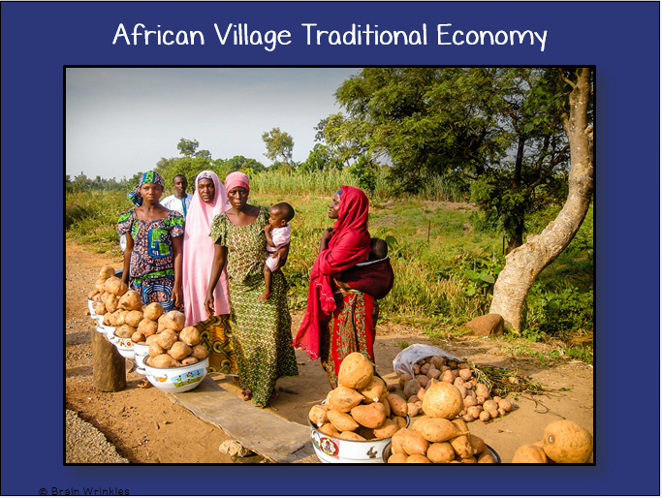
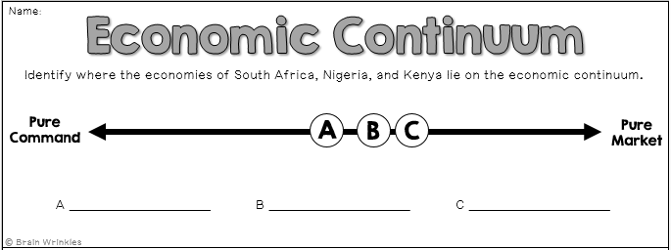
Africa’s
ECONOMIC
SYSTEMS
ECONOMIC
SYSTEMS
Presentation, Graphic Organizers, & Activities

Slide 2
STANDARDS:
SS7E1 Analyze different economic systems.
Compare how traditional, command, and market economies answer the economic questions of 1-what to produce, 2-how to produce, and 3-for whom to produce.
Explain that countries have a mixed economic system located on a continuum between pure market and pure command.
Compare and contrast the economic systems in South Africa, Nigeria, and Kenya.
© Brain Wrinkles

Slide 3
TEACHER INFO: CLOZE Notes
The next pages are handouts for the students to use for note-taking during the presentation. (Print front to back to save paper and ink.)
Check the answers as a class after the presentation.
© Brain Wrinkles

Slide 4
Let’s Review
Do you remember the ___________________ that every country must answer when developing its economic plan?
What goods/services ___________________ ?
___________________ be produced?
___________________ the goods/services?
The way a country answers these questions determines what kind of ___________________ it will have: Traditional, Command, Market
Traditional
All economic decisions are based on customs, traditions, & beliefs ___________________ .
People will make what they always made and do the ___________________ their parents did.
The exchange of goods is done through bartering. Bartering = trading ___________________
___________________ have traditional economies
Command
All economic decisions are made by the ___________________ .
The government owns most of the property, sets the prices of goods, ___________________ of workers, plans what will be made…everything.
This system has not been very successful; more and more countries are ___________________ .
This system is ___________________ to live under; because of this, there are no PURE command countries in the world today.
Some countries are close: ___________________ , former Soviet Union, North Korea, former East Germany, etc.
All of these countries have the same type of government: ___________________ ! The government is in control of everything.
Market
Economic decisions are made based on the ___________________ that occur as buyers & sellers interact in the market place.
The government has ___________________ over the economy; private citizens answer all economic questions.
In a truly free market economy, the government would ___________________ at all. Scary…
There would be ___________________ to make sure goods/services were safe. *Food! Medicine!
There would be no laws to ___________________ from unfair bosses.
Because of this, there are ___________________ economies, but some countries are closer than others.
Hmmm…
Since there are ___________________ that are purely command or purely market, what does that make them?
Most ___________________ have some characteristics of both systems, so we keep it simple and call them: MIXED.
Of course, most countries’ economies are ___________________ of system than another.
© Brain Wrinkles
Africa’s Economic Systems
CLOZE Notes 1

Slide 5
SOUTH AFRICA
Mixed
South Africa has a mixed economic system that is about ___________________ and 35% command.
Its economy is not run entirely ___________________ , nor does it move entirely by free market choices.
South Africa’s government controls some areas like the postal service and ___________________ companies.
3 Questions
How does South Africa answer the ___________________ ?
What to Produce? Individuals and corporations; government has ___________________
How to Produce? ___________________ ; government has some regulations
For Whom to Produce? Individuals and corporations; government has ___________________
Freedom
Throughout the past several decades South Africa has transitioned ___________________ economy and is moving more towards a market one.
South Africa’s national government has let more and more citizens and private corporations ___________________ that it used to own.
The government has loosened its control and now ___________________ among businesses, which has helped the economy grow.
Regulation
While private enterprise is playing a larger role in South Africa’s economy, the national government still as a hand in the country’s ___________________ .
The government operates the ___________________ and some of the communications network.
It also owns some of the oil and gas companies, and ___________________ is both public and private.
Resources
South Africa is an industrialized nation with large ___________________ industries.
It benefits from the ___________________ and minerals found in the country.
South Africa is a well-known producer of diamonds and one of the world’s ___________________ .
Today
During the apartheid era, South Africans suffered under ___________________ .
When apartheid ended in 1990, black South Africans were granted many rights, including the right to own their ___________________ .
This opened up more competition and created a ___________________ in South Africa.
Unfortunately, South Africa is still feeling the effects of apartheid and poverty, crime, and unemployment are ___________________ .
© Brain Wrinkles
Africa’s Economic Systems
CLOZE Notes 2

Slide 6
NIGERIA
Mixed
According to the Index of Economic Freedom, Nigeria has a mixed economic system that is about 60% free and ___________________ .
In 2015, Nigeria surpassed South Africa to become the ___________________ in Africa.
3 Questions
How does Nigeria answer the three ___________________ ?
What to Produce? ___________________ ; government regulates oil and agriculture
How to Produce? Individuals and corporations; government ___________________
For Whom to Produce? Individuals and ___________________ ; government regulates oil and agriculture
Freedom
In recent years, Nigeria has transitioned away from a ___________________ and is moving more towards a market one.
Citizens are ___________________ and start their own businesses.
Regulation
Private enterprise is playing a larger role in Nigeria’s economy; however, the Nigerian government still controls large parts of the country’s two most important industries— ___________________.
Recently, the national government has been giving more control of these industries to private businesses in hopes of ___________________ and the standard of living for Nigerians.
Resources
Nigeria is fortunate in that it has many ___________________ .
___________________, oil was discovered in the country.
Since then, Nigeria’s economy has grown based on its ___________________ to countries around the world.
Nigeria is the ___________________ in Africa.
Today
Since gaining its independence in 1960, Nigeria has been ruled by ruthless ___________________ .
Under strict government control, Nigeria had mostly a ___________________ .
Today, the country is more democratic and the government is ___________________ to its citizens.
Nigeria’s government has been partnering with private businesses to provide greater access to electricity, improve roads, and to ___________________ .
© Brain Wrinkles
Africa’s Economic Systems
CLOZE Notes 3

Slide 7
KENYA
Mixed
Kenya has a mixed economic system that is about ___________________ and 50% command.
High levels of ___________________ have hurt the country’s overall score on the Index of Economic Freedom.
3 Questions
How does Kenya ___________________ economic questions?
What to Produce? ___________________ corporations; government regulates mining, banking, oil refining, & electricity
How to Produce? Some individuals and corporations; ___________________ mining, banking, oil refining, & electricity
For Whom to Produce? Some individuals and corporations; government regulates mining, banking, oil refining, & ___________________
Freedom
Kenya’s citizens are allowed to own property and start ___________________ .
Businesses decide what to produce and how, and ___________________ for their products.
Unfortunately, because of corruption and bribery in Kenya’s government, laws meant to protect businesses are ___________________ .
Regulation
Kenya’s government owns all or part of several industries including ___________________ , electricity, mining, and oil refining.
Resources
Kenya is the banking, transportation ,and ___________________ hub of East Africa.
Agriculture, ___________________ , and manufacturing have helped Kenya become the strongest economy in the region.
Today
In recent years, Kenya’s agriculture industry has ___________________ .
Also, the tourism industry has declined due to ___________________ within the region.
Fortunately, Kenya’s ___________________ .
Economists predict that it will continue to ___________________ as the quality of life for Kenyans improves.
© Brain Wrinkles
Africa’s Economic Systems
CLOZE Notes 4

Slide 8
Africa’s
Economic
Systems
South Africa, Nigeria,
and Kenya

Slide 9
Let’s Review
Do you remember the three questions that every country must answer when developing its economic plan?
What goods/services will be produced?
How will goods/services be produced?
Who will consume the goods/services?
The way a country answers these questions determines what kind of economic system it will have:
Traditional Command Market

Slide 10
Traditional
All economic decisions are based on customs, traditions, & beliefs of the past.
People will make what they always made and do the same things their parents did.
The exchange of goods is done through bartering.
Bartering = trading without using money
Rural African villages have traditional economies.

Slide 11
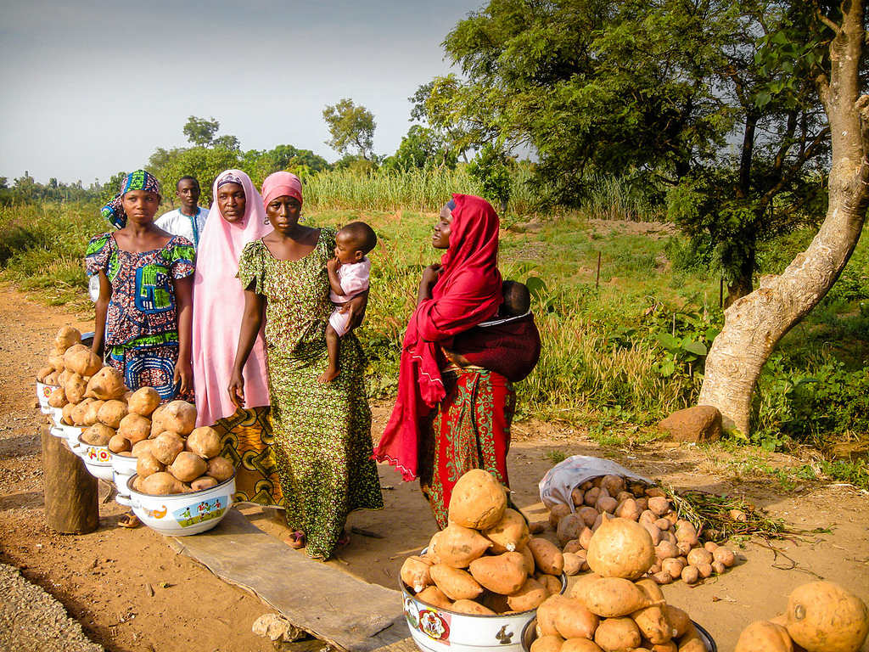
African Village Traditional Economy

Slide 12
Command
All economic decisions are made by the Government.
The government owns most of the property, sets the prices of goods, determines the wages of workers, plans what will be made…everything.
This system has not been very successful; more and more countries are abandoning it.

Slide 13
Command
This system is very harsh to live under; because of this, there are no PURE command countries in the world today.
Some countries are close: Cuba, former Soviet Union, North Korea, former East Germany, etc.
All of these countries have the same type of government: Communist! The government is in control of everything.

Slide 14
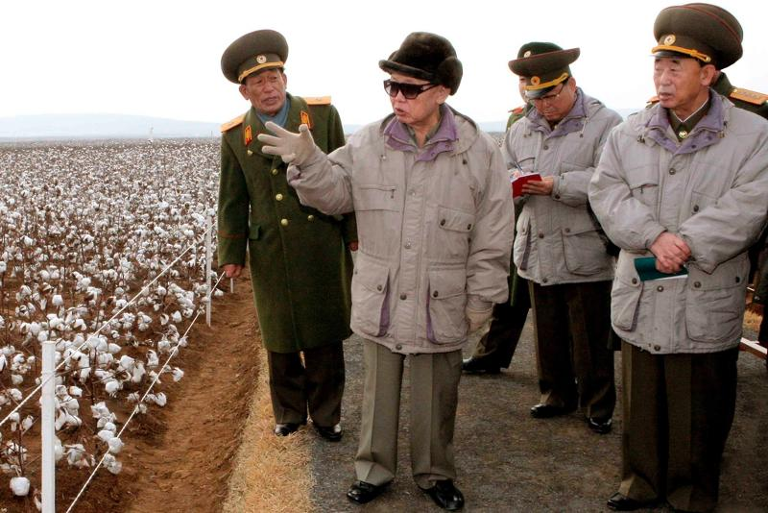
North Korea’s Command Economy

Slide 15
Market
Economic decisions are made based on the changes in prices that occur as buyers & sellers interact in the market place.
The government has no control over the economy; private citizens answer all economic questions.
In a truly free market economy, the government would not be involved at all. Scary…
There would be no laws to make sure goods/services were safe. *Food! Medicine!
There would be no laws to protect workers from unfair bosses.
Because of this, there are no PURE market economies, but some countries are closer than others.

Slide 16
Hmmm…
Since there are no countries that are purely command or purely market, what does that make them?
Most democratic countries have some characteristics of both systems, so we keep it simple and call them: MIXED.
Of course, most countries’ economies are closer to one type of system than another.

Slide 17
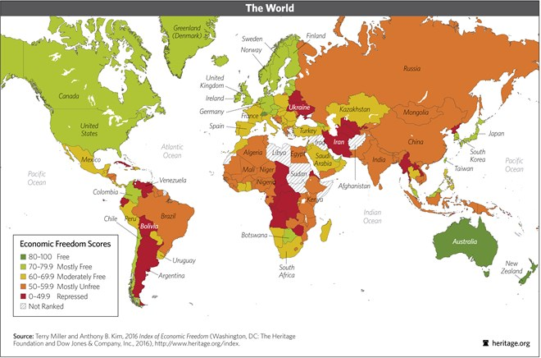
2016 Index of Economic Freedom

Slide 18
SOUTH
AFRICA

Slide 19
Mixed
South Africa has a mixed economic system that is about 65% free and 35% command.
Its economy is not run entirely by the government, nor does it move entirely by free market choices.
South Africa’s government controls some areas like the postal service and some oil and gas companies.

Slide 20
3 Questions
How does South Africa answer the three economic questions?
What to Produce? Individuals and corporations; government has some regulations
How to Produce? Individuals and corporations; government has some regulations
For Whom to Produce? Individuals and corporations; government has some regulations

Slide 21
Freedom
Throughout the past several decades South Africa has transitioned away from a command economy and is moving more towards a market one.
South Africa’s national government has let more and more citizens and private corporations take over industries that it used to own.
The government has loosened its control and now encourages competition among businesses, which has helped the economy grow.

Slide 22
Regulation
While private enterprise is playing a larger role in South Africa’s economy, the national government still as a hand in the country’s economic planning.
The government operates the postal service and some of the communications network.
It also owns some of the oil and gas companies, and healthcare is both public and private.

Slide 23
Resources
South Africa is an industrialized nation with large service and manufacturing industries.
It benefits from the abundant precious metals and minerals found in the country.
South Africa is a well-known producer of diamonds and one of the world’s top producers of gold.

Slide 24
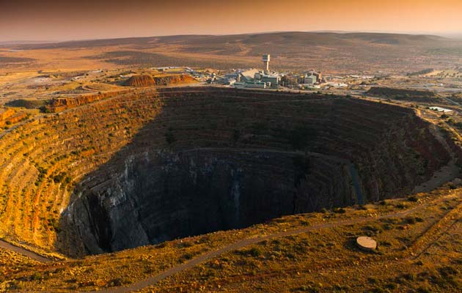
Finsch Diamond Mine, South Africa

Slide 25
Today
During the apartheid era, South Africans suffered under segregation laws.
When apartheid ended in 1990, black South Africans were granted many rights, including the right to own their own businesses.
This opened up more competition and created a stronger market economy in South Africa.
Unfortunately, South Africa is still feeling the effects of apartheid and poverty, crime, and unemployment are problems the country faces.

Slide 26
What have I learned about the economy of South Africa?
At the bottom of the page, summarize your notes by writing a haiku.
(A haiku is a poem consisting of three lines. The first line has 5 syllables; the second line has 7 syllables; and the third line has 5 syllables. Rhyming is NOT necessary.

Slide 27
Example of Haiku Related to Economic Systems
Market is freedom (5)
Total control is command (7)
Mixed is some of each (5)

Slide 28
NIGERIA

Slide 29
Mixed
According to the Index of Economic Freedom, Nigeria has a mixed economic system that is about 60% free and 40% command.
In 2015, Nigeria surpassed South Africa to become the largest economy in Africa.

Slide 30
3 Questions
How does Nigeria answer the three economic questions?
What to Produce? Individuals and corporations; government regulates oil and agriculture
How to Produce? Individuals and corporations; government regulates oil and agriculture
For Whom to Produce? Individuals and corporations; government regulates oil and agriculture

Slide 31
Freedom
In recent years, Nigeria has transitioned away from a mostly command economy and is moving more towards a market one.
Citizens are free to own property and start their own businesses.

Slide 32
Regulation
Private enterprise is playing a larger role in Nigeria’s economy; however, the Nigerian government still controls large parts of the country’s two most important industries—oil and agriculture.
Recently, the national government has been giving more control of these industries to private businesses in hopes of improving the economy and the standard of living for Nigerians.

Slide 33
Resources
Nigeria is fortunate in that it has many valuable natural resources.
In the 1970s, oil was discovered in the country.
Since then, Nigeria’s economy has grown based on its ability to export oil to countries around the world.
Nigeria is the largest producer of oil in Africa.

Slide 34
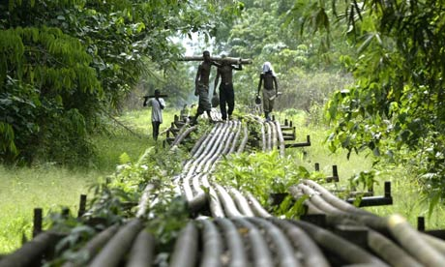
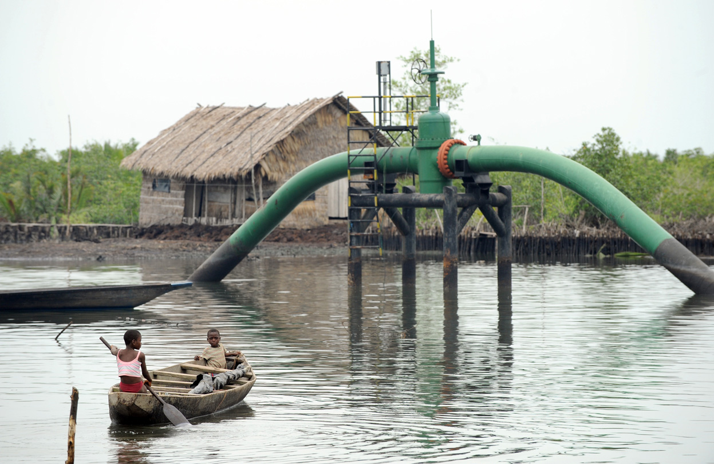
Nigerian Oil Pipes

Slide 35
Today
Since gaining its independence in 1960, Nigeria has been ruled by ruthless military dictatorships.
Under strict government control, Nigeria had mostly a command economy.
Today, the country is more democratic and the government is giving more economic freedom to its citizens.
Nigeria’s government has been partnering with private businesses to provide greater access to electricity, improve roads, and to increase agriculture.

Slide 36
What have I learned about the economy of Nigeria?
At the bottom of the page, write a minimum of two sentences. Explain similarities and differences between the economies of South Africa and Nigeria.

Slide 37
KENYA

Slide 38
Mixed
Kenya has a mixed economic system that is about 50% free and 50% command.
High levels of corruption in Kenya’s government have hurt the country’s overall score on the Index of Economic Freedom.

Slide 39
3 Questions
How does Kenya answer the three economic questions?
What to Produce? Some individuals and corporations; government regulates mining, banking, oil refining, & electricity
How to Produce? Some individuals and corporations; government regulates mining, banking, oil refining, & electricity
For Whom to Produce? Some individuals and corporations; government regulates mining, banking, oil refining, & electricity

Slide 40
Freedom
Kenya’s citizens are allowed to own property and start their own businesses.
Businesses decide what to produce and how, and what prices to charge for their products.
Unfortunately, because of corruption and bribery in Kenya’s government, laws meant to protect businesses are not always fairly enforced.

Slide 41
Regulation
Kenya’s government owns all or part of several industries including banking, electricity, mining, and oil refining.

Slide 42
Resources
Kenya is the banking, transportation ,and communication hub of East Africa.
Agriculture, tourism, and manufacturing have helped Kenya become the strongest economy in the region.

Slide 43
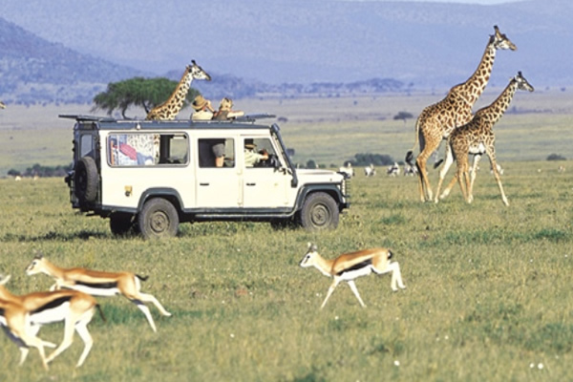
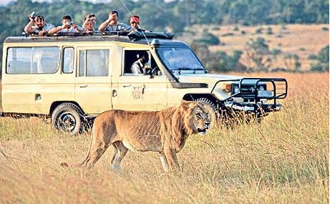
Safari Tour in Kenya

Slide 44
Today
In recent years, Kenya’s agriculture industry has suffered from drought.
Also, the tourism industry has declined due to terrorist activity within the region.
Fortunately, Kenya’s economy is recovering.
Economists predict that it will continue to grow stronger as the quality of life for Kenyans improves.

Slide 45
What have I learned about the economy of Kenya?
At the bottom of the page, in a minimum of 3 complete sentences, describe some of the pros and cons of Kenya’s economy.

Slide 46
Africa’s Economic Systems
Directions: Complete the chart below with information that you learned during the presentation.
 | Economic System | What do Private Citizens and Companies Decide? | What Does the Government Control? | Economic Struggles
South Africa
Nigeria
Kenya
© Brain Wrinkles

Slide 47
Brochure
Create a brochure that compares the economic systems of South Africa, Nigeria, and Kenya.
You will summarize each country’s economy, as well as include an illustration to represent it.
Include information about each country’s economic system, freedoms, regulations, resources, etc.
Also, in one of the boxes, you will give your opinion about which economy you would prefer to live under and why.
© Brain Wrinkles

Slide 48
TEACHER INFO:
Print off the chart below for each student.
They should complete the charts after discussing the presentation.
Check answers as a class when finished.
© Brain Wrinkles

Slide 49
TEACHER INFO: Economic Systems Brochure
Print off the Economic Systems Brochure handouts for each student. (There are two pages, so print front-to-back.)
Display the Brochure directions slide onto the board.
The students will create a brochure to compare the economies of South Africa, Nigeria, and Kenya.
They should include information about each country’s economic system, freedoms, regulations, etc.
They will also write their opinion on which economy they would prefer to live under and why.
© Brain Wrinkles

Slide 50
1. What are the three economic questions that every country must answer?
2. How do members of a traditional economy trade goods?
3. In a traditional economy, economic decisions are made based on what?
4. How does a command economic system answer the three economic questions?
5. Who owns all property and resources in a pure market economy?
6. Most democratic countries have elements of which two economic systems?
7. What type of economic system is found in South Africa, Nigeria, and Kenya?
8. What role does South Africa’s government play in its economy?
9. Which African country has the strongest economy?
10. Which resource is the most important to Nigeria’s economy?
11. Every economy has at least some government control. Why do you think some government control is necessary?
© Brain Wrinkles
Africa’s Economic Systems
Comprehension Check

