Slide 1
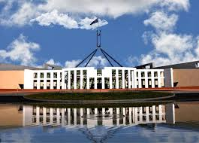
Key points about government
SS6CG6 Compare and contrast various forms of government.
SS6CG7 Explain the structure of the national government of Australia.

Slide 2
How is a direct democracy different from a representative democracy?
DIRECT DEMOCRACY
REPRESENTATIVE DEMOCRACY
A "pure democracy" in which the people themselves, rather than elected representatives, determine their own laws and policies.
Eligible citizens of a country vote for representatives to pass laws for them.

Slide 3
How is an absolute monarchy different from a constitutional monarchy?
ABSOLUTE MONARCHY
CONSTITUTIONAL MONARCHY
The monarch has TOTAL power over the people with no restrictions on his/her power.
The powers of the ruler are restricted (limited) by the constitution and laws of the nation.

Slide 4
What is the difference between the head of state and the head of government?
HEAD OF GOVERNMENT
HEAD OF STATE
THE CHIEF REPRESENTATIVE OF A COUNTRY WITH MORE CEREMONIAL DUTIES.
RESPONSIBLE FOR RUNNING THE GOVERNMENT.

Slide 5
What are the key government terms to describe Australia’s government?
1) FEDERAL
2) CONSTITUTIONAL MONARCHY
3) PARLIAMENTARY DEMOCRACY
4) REPRESENTATIVE DEMOCRACY

